Slide 1
Caravan Insurance
Project Group 3
Aurelia Arnett, Patrick Aslakson, Paul Antioch
Notes:
Aureila

Slide 2
Project Information
Goal:
Can we identify a segment(s) of the data who would be most likely to buy a caravan insurance policy? (A caravan policy is a policy on a towable camping trailer)
Data set:
Contains information on customers of an insurance company.
Consists of 86 variables, includes product usage and socio-demographic data derived from zip codes.
https://www.kaggle.com/uciml/caravan-insurance-challenge#caravan-insurance-challenge.csv
Notes:
Aurelia

Slide 3
Evaluation Methods
Naïve Bayes Classifier
K-Means Clustering
Logistic Regression
Random Forest
Notes:
Aurelia

Slide 4

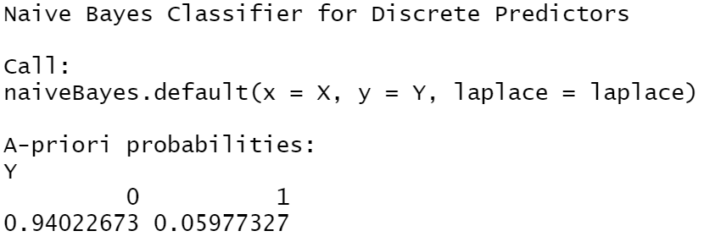
Naïve Bayes
Purpose: to understand customer classifiers based on the averages of independent variables of CARAVAN policy holders.
These averages will be used to further discuss if our segmentation results identify CARAVAN customers
Based on the Naïve Bayes model, about 6% of people in the dataset are CARAVAN customers
Notes:
Aurelia

Slide 5

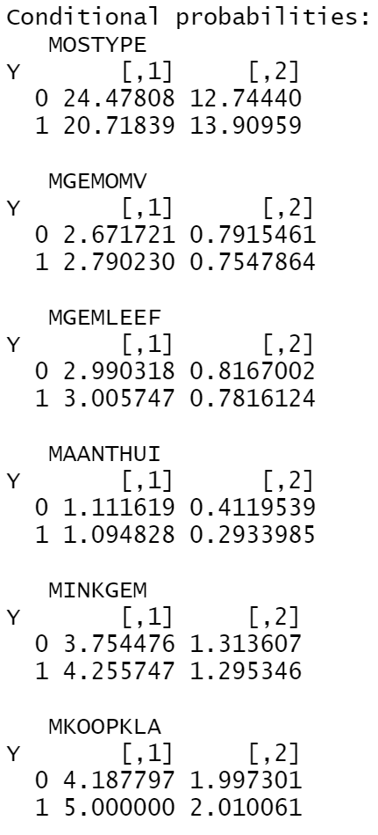
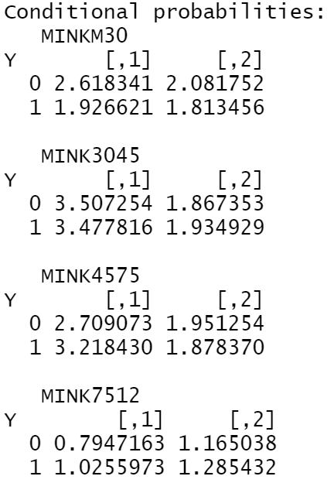
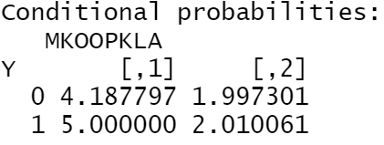
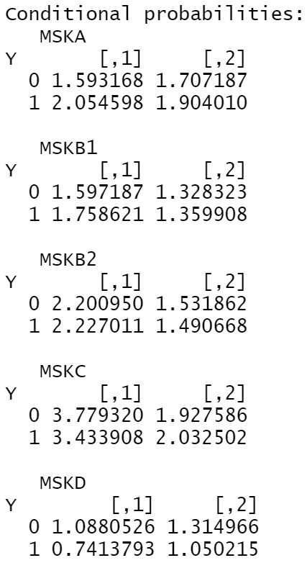
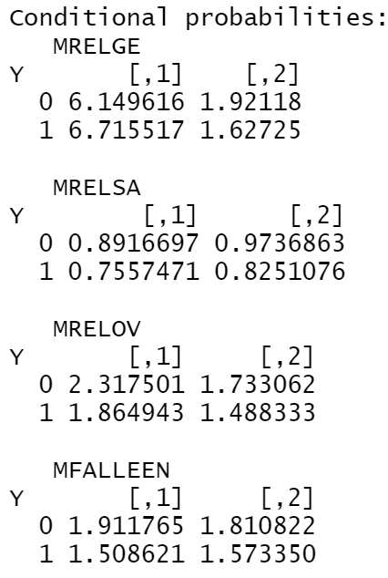
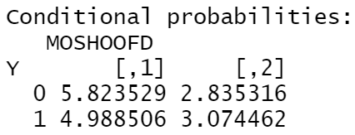
Naïve Bayes
Where column 1 represents the average and column 2 represents the standard deviation of customers within that variable type who are customers and non-customers
Demographic Data | Social Variables | Purchasing Power | Social Class | Household Demographics | Type of customer
Notes:
Aurelia

Slide 6

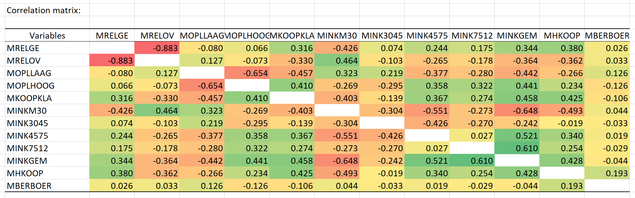

Logistic Regression
Signif. codes: 0 '***' 0.001 '**' 0.01 '*' 0.05 '.' 0.1 ' ' 1
Coefficients: Estimate Std. Error z value Pr(>|z|)
(Intercept) 112.89801 1858.48447 0.061 0.951560
MZPART -13.25126 206.49823 -0.064 0.948834
MZFONDS -13.22678 206.49823 -0.064 0.948928
MSKD -0.03671 0.06324 -0.580 0.561603
MSKC -0.04564 0.06470 -0.705 0.480597
MSKB2 -0.07649 0.05904 -1.296 0.195107
MSKB1 -0.08361 0.06382 -1.310 0.190171
MSKA -0.07347 0.06654 -1.104 0.269514
MRELSA 0.02823 0.09807 0.288 0.773467
MRELOV 0.18274 0.10337 1.768 0.077089 .
MRELGE 0.21969 0.10699 2.053 0.040047 *
MOPLMIDD -0.01360 0.09662 -0.141 0.888055
MOPLLAAG -0.09634 0.09820 -0.981 0.326560
MOPLHOOG 0.04729 0.09272 0.510 0.610068
MKOOPKLA 0.06815 0.02862 2.381 0.017260 *
MINKM30 0.16850 0.06864 2.455 0.014091 *
MINKGEM 0.12120 0.06381 1.899 0.057513 .
MINK7512 0.09580 0.06384 1.501 0.133449
MINK4575 0.18282 0.06079 3.007 0.002635 **
MINK3045 0.21414 0.06374 3.359 0.000781 ***
MHKOOP 0.05700 0.01844 3.091 0.001998 **
MFGEKIND -0.01306 0.02786 -0.469 0.639131
MFALLEEN -0.02456 0.04032 -0.609 0.542471
MBERBOER -0.28395 0.06197 -4.582 0.0000046 ***
Variables in yellow are significant in determining CARAVAN customers. These variables were what was also used to define the K-means Clustering.
With a hit rate of 81%, we are 81% confident that the variables listed are significant variables in determining CARAVAN customers
Average income (MINKGEM) and an income between $75K-$122K (MINK7512) are strongly correlated variables (the higher the % of incomes in the $75-$122k range drives up the average income)
Notes:
Patrick

Slide 7
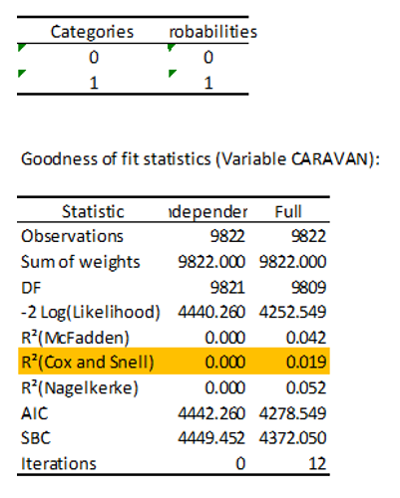
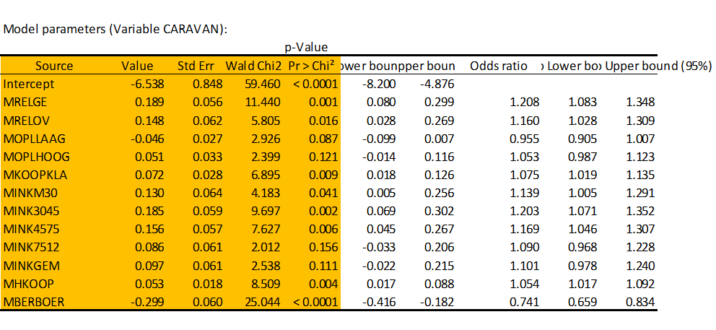
Logistic Regression
Correspondence between the categories of the response variable and the probabilities (variable CARAVAN)
Notes:
Patrick

Slide 8

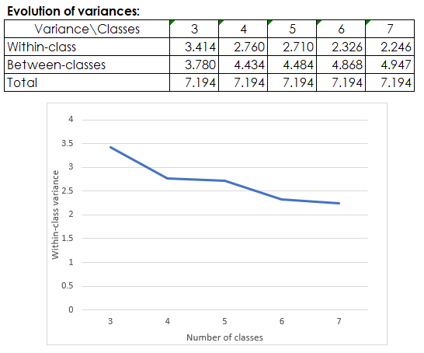
K-Means Clustering
K-Means clustering was performed to segment the data set
Variables used in segmentation
Number of houses
Average household size
Average age
Average income
Purchasing power class
Based on the elbow plot, 6 segments were chosen
Now we will compare the 6 segments to the Naïve Bayes results for the current customers
Notes:
Paul

Slide 9

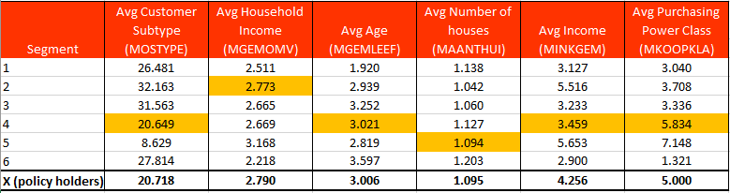
K-Means to Naïve Bayes Analysis: Demographic Data
Segment variables that align closest to policy holders are highlighted in orange
Notes:
Paul

Slide 10
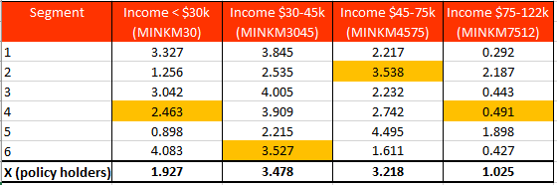
K-Means to Naïve Bayes Analysis: Income Data
Segment variables that align closest to policy holders are highlighted in orange
Notes:
Paul

Slide 11
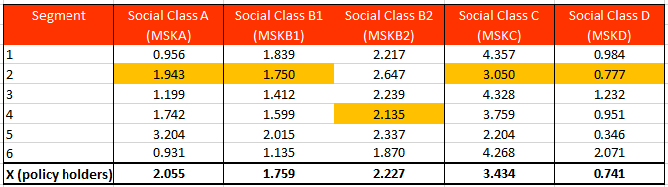
K-Means to Naïve Bayes Analysis: Social Class
Segment variables that align closest to policy holders are highlighted in orange
Notes:
Paul

Slide 12
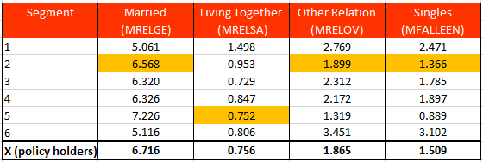
K-Means to Naïve Bayes Analysis: Household Demographics
Segment variables that align closest to policy holders are highlighted in orange
Notes:
Paul

Slide 13
Analysis Summary
Segments 1, 3, and 6 do not align with current policy holders.
Segments 2, 4, and 5 align with current policy holders, based on the fields used in segmentation. Looking at additional information, this is how they compare to policy holders:
Segment | Income Levels | Purchasing Power | Social Class | Living situations | House with vs without children | Education levels
Segment 2 | higher incomes | lower | similar makeup | similar makeup | similar ratio | similar education levels
Segment 4 | lower incomes | higher | larger concentration of skilled working class | less married households-more living together and ‘other’ | similar ratio | larger amount of lower education levels
Segment 5 | higher incomes | higher | larger concentration of upper middle class | more married households | larger number of houses without children | larger amount of lower education levels
Segments 2 and 4 contain customers with a profile similar to current policy holders
Segment 2 - despite having a smaller amount of customers, aligns well with the profile of current policy holders, customers in the segment tend to have higher incomes that current policy holders.
Segment 4 contains a large number of ‘Driven Growers’ which have the highest policy purchasing rate of any customer types. (~2x more likely to be a CARAVAN policy holder than other customer types)
Segment 5, contains older individuals, whom are less likely to be policy holders, and household size makeup that does not align with current policy holders.
Notes:
Paul

Slide 14

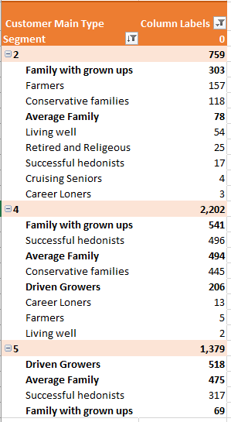
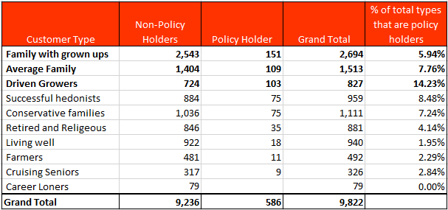
Customer Type Analysis
Families w/grown ups, average families, driven growers make up 61.94% of policy holders.
The top 3 customer types in our target segments are as follows:
Segment 2 – 50.19%
Segment 4 - 56.35%
Segment 5 – 77.01%
Notes:
Paul

Slide 15

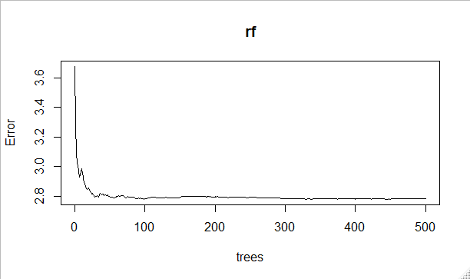
Random Forest
Call:
randomForest(x = rfdata[, -5], y = rfdata[, 5])
Type of random forest: regression
Number of trees: 500
No. of variables tried at each split: 1
Mean of squared residuals: 2.764606
% Var explained: 30.8
> attributes(rf)
$names
[1] "call" "type" "predicted" "mse"
[5] "rsq" "oob.times" "importance" "importanceSD"
[9] "localImportance" "proximity" "ntree" "mtry"
[13] "forest" "coefs" "y" "test"
[17] "inbag"
$class
[1] "randomForest"
> plot(rf)
Purpose: to examine the key variables that determine a CARAVAN Policy holder
The above graph shows the diminishing error as the number of samples increases.
Results inconclusive, through multiple attempts due to R warning to ‘re-grow the forest’. (to start over with full data set)
Random forest analysis not fit for this sample of data.
Notes:
Patrick

Slide 16

Wrap-Up
Naïve Bayes used determine the ‘typical’ CARAVAN policy holder
Logistic Regression to determine significant variables in determining a CARAVAN Policy Holder
K-Means clustering used to segment non-customers into like groups based on significant factors from linear regression. These segments were then compared to the result of the Naïve bayes.
Random Forest results proved inconclusive.
Certain segments aligned closer to the makeup of current CARAVAN policy holders.
Notes:
Aurelia

Slide 17

Thank You!

Slide 18

Appendix
The following slides contain supplemental information and graphs created during our analysis of the data set

Slide 19

Data Definitions
ORIGIN: train or test, as described above
MOSTYPE: Customer Subtype; see L0
MAANTHUI: Number of houses 1 - 10
MGEMOMV: Avg size household 1 - 6
MGEMLEEF: Avg age; see L1
MOSHOOFD: Customer main type; see L2
MGODRK: Roman catholic
MGODPR: Protestant …
MGODOV: Other religion
MGODGE: No religion
MRELGE: Married
MRELSA: Living together
MRELOV: Other relation
MFALLEEN: Singles
MFGEKIND: Household without children
MFWEKIND: Household with children
MOPLHOOG: High level education
MOPLMIDD: Medium level education
MOPLLAAG: Lower level education
MBERHOOG: High status
MBERZELF: Entrepreneur
MBERBOER: Farmer
MBERMIDD: Middle management
MBERARBG: Skilled labourers
MBERARBO: Unskilled labourers
MSKA: Social class A
MSKB1: Social class B1
MSKB2: Social class B2
MSKC: Social class C
MSKD: Social class D
MHHUUR: Rented house
MHKOOP: Home owners
MAUT1: 1 car
MAUT2: 2 cars
MAUT0: No car
MZFONDS: National Health Service
MZPART: Private health insurance
MINKM30: Income < 30.000
MINK3045: Income 30-45.000
MINK4575: Income 45-75.000
MINK7512: Income 75-122.000
MINK123M: Income >123.000
MINKGEM: Average income
MKOOPKLA: Purchasing power class
PWAPART: Contribution private third party insurance
PWABEDR: Contribution third party insurance (firms)
PWALAND: Contribution third party insurane (agriculture)
PPERSAUT: Contribution car policies
PBESAUT: Contribution delivery van policies
PMOTSCO: Contribution motorcycle/scooter policies
PVRAAUT: Contribution lorry policies
PAANHANG: Contribution trailer policies
PTRACTOR: Contribution tractor policies
PWERKT: Contribution agricultural machines policies
PBROM: Contribution moped policies
PLEVEN: Contribution life insurances
PPERSONG: Contribution private accident insurance policies
PGEZONG: Contribution family accidents insurance policies
PWAOREG: Contribution disability insurance policies
PBRAND: Contribution fire policies
PZEILPL: Contribution surfboard policies
PPLEZIER: Contribution boat policies
PFIETS: Contribution bicycle policies
PINBOED: Contribution property insurance policies
PBYSTAND: Contribution social security insurance policies
AWAPART: Number of private third party insurance 1 - 12
AWABEDR: Number of third party insurance (firms) …
AWALAND: Number of third party insurance (agriculture)
APERSAUT: Number of car policies
ABESAUT: Number of delivery van policies
AMOTSCO: Number of motorcycle/scooter policies
AVRAAUT: Number of lorry policies
AAANHANG: Number of trailer policies
ATRACTOR: Number of tractor policies
AWERKT: Number of agricultural machines policies
ABROM: Number of moped policies
ALEVEN: Number of life insurances
APERSONG: Number of private accident insurance policies
AGEZONG: Number of family accidents insurance policies
AWAOREG: Number of disability insurance policies
ABRAND: Number of fire policies
AZEILPL: Number of surfboard policies
APLEZIER: Number of boat policies
AFIETS: Number of bicycle policies
AINBOED: Number of property insurance policies
ABYSTAND: Number of social security insurance policies
CARAVAN: Number of mobile home policies 0 - 1

Slide 20
Data Definitions
Keys (L1 - L4)
L0: Customer subtype
1: High Income, expensive child
2: Very Important Provincials
3: High status seniors
4: Affluent senior apartments
5: Mixed seniors
6: Career and childcare
7: Dinki's (double income no kids)
8: Middle class families
9: Modern, complete families
10: Stable family
11: Family starters
12: Affluent young families
13: Young all american family
14: Junior cosmopolitan
15: Senior cosmopolitans
16: Students in apartments
17: Fresh masters in the city
18: Single youth
19: Suburban youth
20: Etnically diverse
21: Young urban have-nots
22: Mixed apartment dwellers
23: Young and rising
24: Young, low educated
25: Young seniors in the city
26: Own home elderly
27: Seniors in apartments
28: Residential elderly
29: Porchless seniors: no front yard
30: Religious elderly singles
31: Low income catholics
32: Mixed seniors
33: Lower class large families
34: Large family, employed child
35: Village families
36: Couples with teens 'Married with children'
37: Mixed small town dwellers
38: Traditional families
39: Large religous families
40: Large family farms
41: Mixed rurals
L3: percentage keys:
0: 0%
1: 1 - 10%
2: 11 - 23%
3: 24 - 36%
4: 37 - 49%
5: 50 - 62%
6: 63 - 75%
7: 76 - 88%
8: 89 - 99%
9: 100%
L4: total number keys:
0: 0
1: 1 - 49
2: 50 - 99
3: 100 - 199
4: 200 - 499
5: 500 - 999
6: 1000 - 4999
7: 5000 - 9999
8: 10,000 - 19,999
9: >= 20,00
L1: average age keys:
1: 20-30 years 2: 30-40 years 3: 40-50 years 4: 50-60 years 5: 60-70 years 6: 70-80 years
L2: customer main type keys:
1: Successful hedonists
2: Driven Growers
3: Average Family
4: Career Loners
5: Living well
6: Cruising Seniors
7: Retired and Religeous
8: Family with grown ups
9: Conservative families
10: Farmers

Slide 21
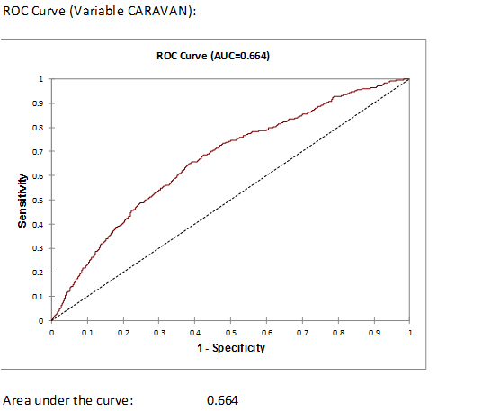
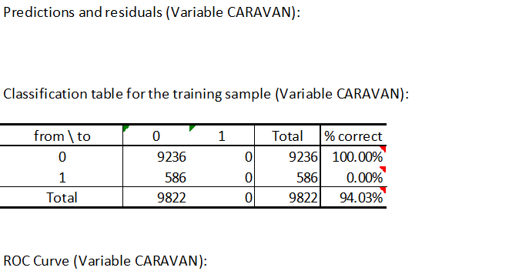
Logistic Regression

Slide 22
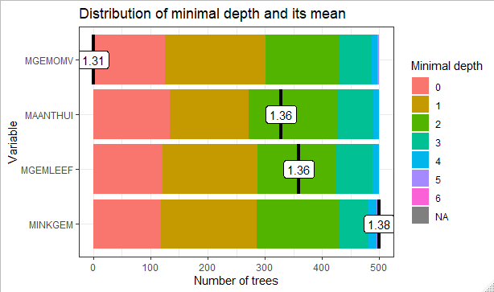
Random Forest
Minimum depth of ‘Relevant Trees’
Graph to the right shows ‘depth’ (how man times each variable was sampled in a tree) for all variables
Graph shows the mean for the relevant variables has increased from the all trees graph
Additional graphs on next slide shows depth for top variables.

Slide 23
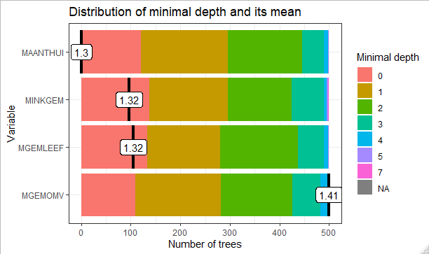
Random Forest
> head(min_depth_frame, n = 15)
tree variable minimal_depth
1 1 MAANTHUI 0
2 1 MGEMLEEF 1
3 1 MGEMOMV 1
4 1 MINKGEM 2
5 2 MAANTHUI 4
6 2 MGEMLEEF 0
7 2 MGEMOMV 3
8 2 MINKGEM 1
9 3 MAANTHUI 1
10 3 MGEMLEEF 0
11 3 MGEMOMV 2
12 3 MINKGEM 1
13 4 MAANTHUI 0
14 4 MGEMLEEF 4
15 4 MGEMOMV 2

Slide 24
Random Forest
plot_min_depth_distribution(min_depth_frame, mean_sample = "relevant_trees", k = 15)
> importance_frame <- measure_importance(rf)
[1] "Warning: your forest does not contain information on local importance so 'mse_increase' measure cannot be extracted. To add it regrow the forest with the option localImp = TRUE and run this function again.“
So, in conclusion of the RF test, R suggests we ‘regrow the forest’, or start with a full dataset and cull the variables down from the original dataset. Finding from RF are inconclusive without further analysis.

